Slide 1

Wellness Tourism Package Expansion
A Travel and Tourism company is aiming to expand its customer base by introducing a new Wellness Tourism Package. Despite offering five types of packages, the company's marketing strategy, which involved contacting customers at random, led to high costs with only 18% of customers purchasing packages. This project seeks to leverage customer data to optimize marketing efforts, reduce expenditure, and effectively target potential customers for the new package offering. This is crucial for establishing a viable business model and expanding the market share in the competitive travel industry.

Slide 2
Team Member
Olivia Deep data analysis Secondary Tableau visualizations
Rishabh Predictive modelling to identify potential buyers Secondary Deep data analysis
Rachit Data cleaning and integration process to prep data for analysis Secondary Predictive modelling
Atharva Tableau dashboards to visualize trends and insights Secondary Data cleaning and integration
Ariv Designing marketing strategies for customer segments Secondary Ensuring accuracy of data
Avishkar Ensuring accuracy of data Secondary Designing marketing strategies for customer segments

Slide 3
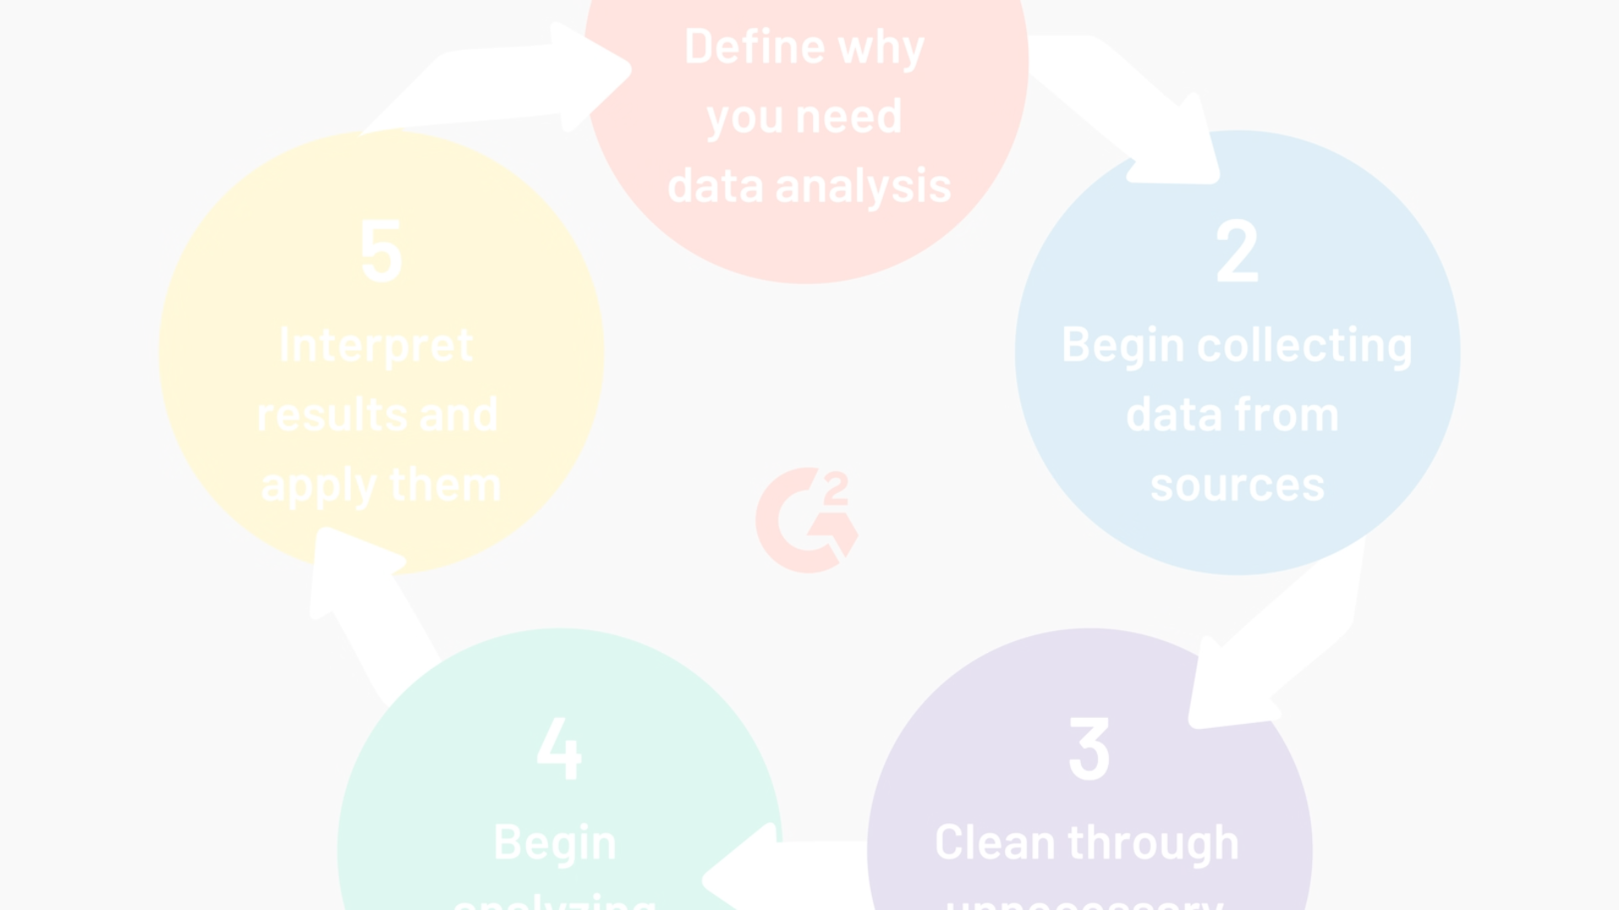
Data Analysis Methodology
Data Cleaning
Key Customer Segments
Predictive Modeling
The team will conduct a comprehensive data analysis using Python for data cleaning, transformation, and modeling.
We aim to identify key customer segments and predict potential buyers of the new package.
We aim to identify key customer segments and predict potential buyers of the new package.

Slide 4



Optimizing Marketing Strategies
Efficiency
The findings will guide the marketing team in making data-driven decisions and tailoring their strategies to specific customer segments, thereby increasing the efficiency and effectiveness of marketing expenditure.
Cost Reduction
This project seeks to leverage customer data to optimize marketing efforts, reduce expenditure, and effectively target potential customers for the new package offering.
Targeted Marketing
The findings will guide the marketing team in making data-driven decisions and tailoring their strategies to specific customer segments, thereby increasing the efficiency and effectiveness of marketing expenditure.

Slide 5
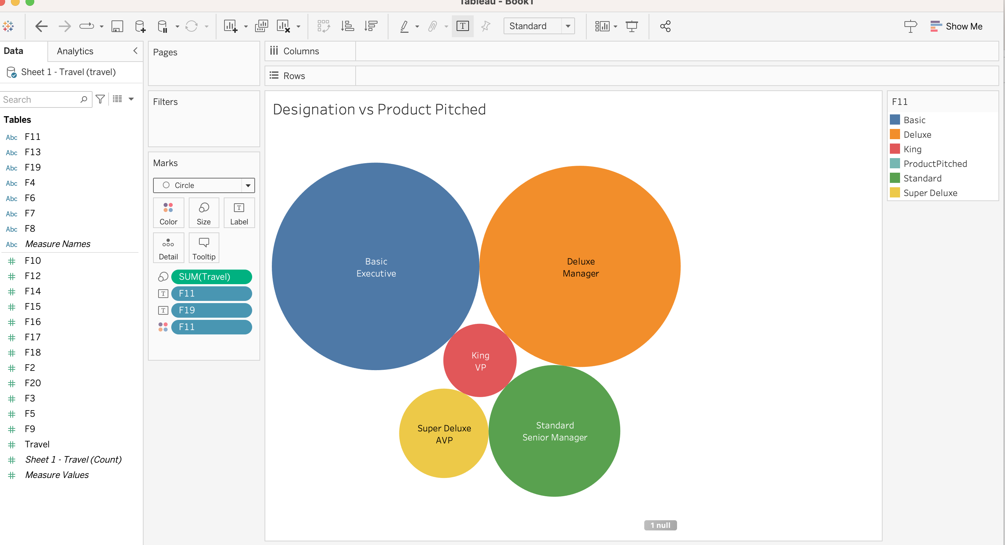
Exploratory Work

Slide 6
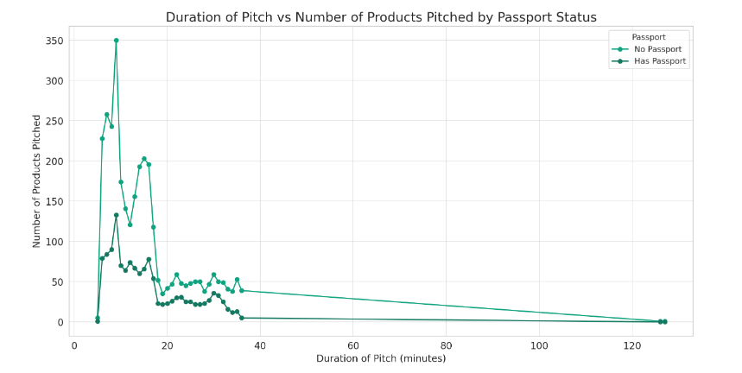
Analysis 2
Initial Surge for Non-Passport Holders
High Variability for Non-Passport Holders
Downward Trend in Engagement
Steady Approach for Passport Holders
Leveling Off After 20 Minutes

Slide 7
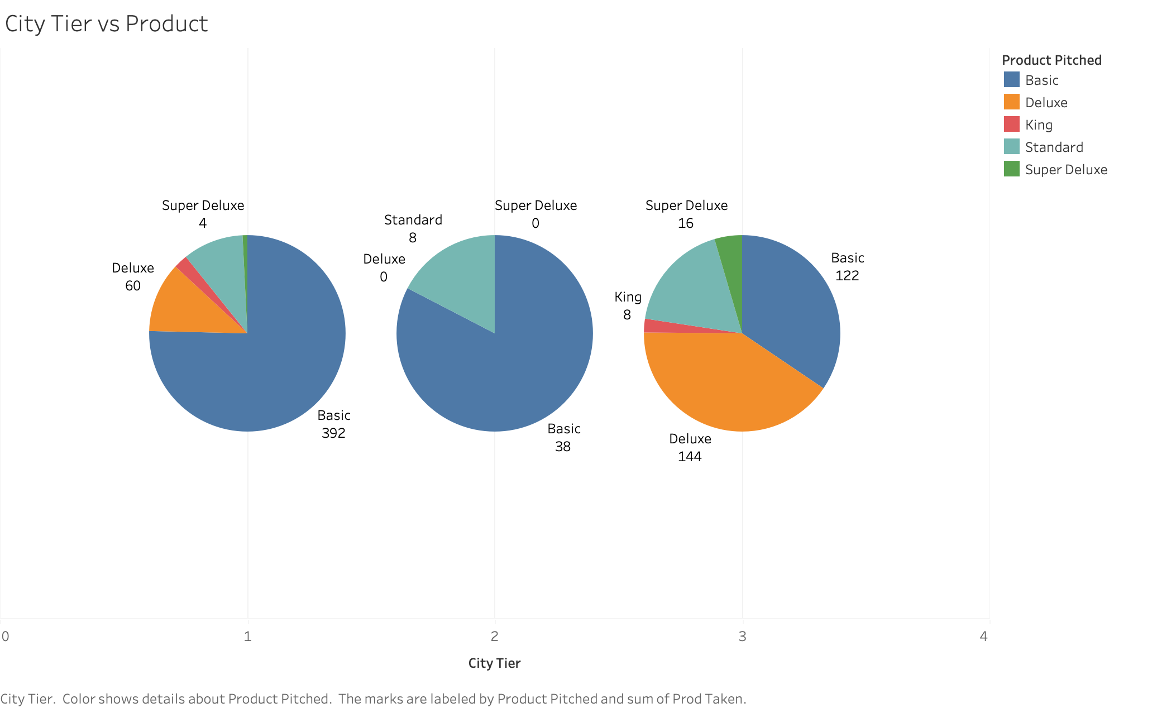
Analysis 3
City Tier 1 favors Basic products, with lesser demand for Deluxe and Super Deluxe, and minimal to none for King and Standard.
Basic products dominate City Tier 2, with a minor presence of Standard.
City Tier 3 has a varied mix, led by Deluxe and Basic, trailed by Super Deluxe and King, and least for Standard.

Slide 8
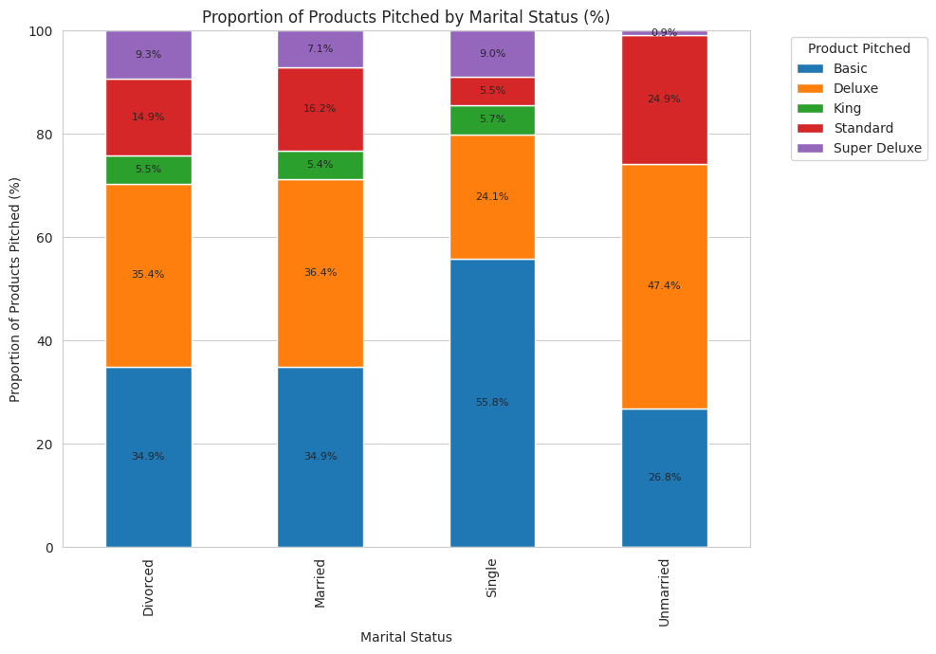
Analysis 4
'Basic' products are predominantly pitched to singles, suggesting a focus on affordability or individual use.
Married individuals are targeted with a balanced mix of 'Basic' and 'Deluxe' products, indicating diverse marketing approaches.
'Deluxe' products are the most pitched to unmarried individuals, pointing to a potential preference for higher-end products in this segment.
'King' and 'Super Deluxe' have the least presence across all marital statuses, implying a niche or selective market focus.

Slide 9
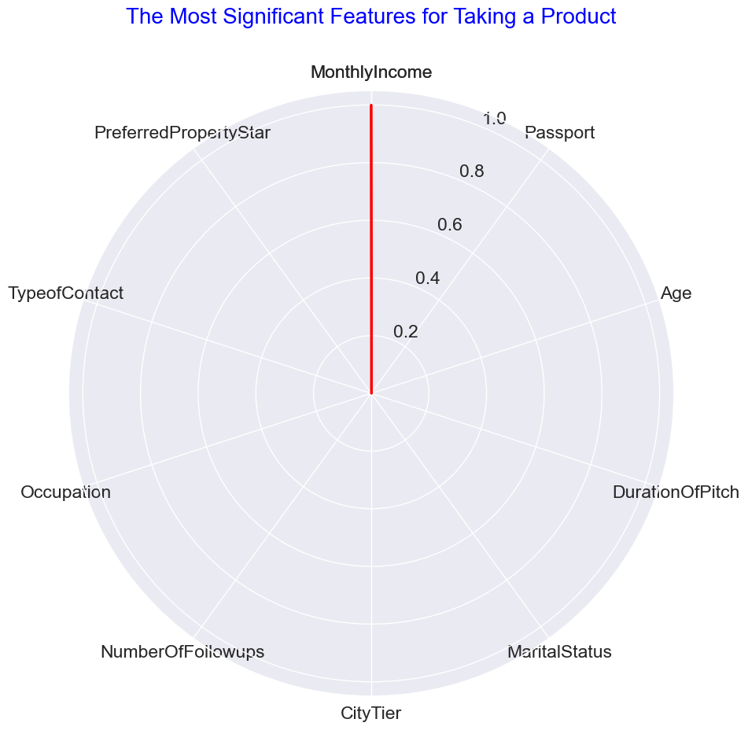
Analysis 5

Slide 11
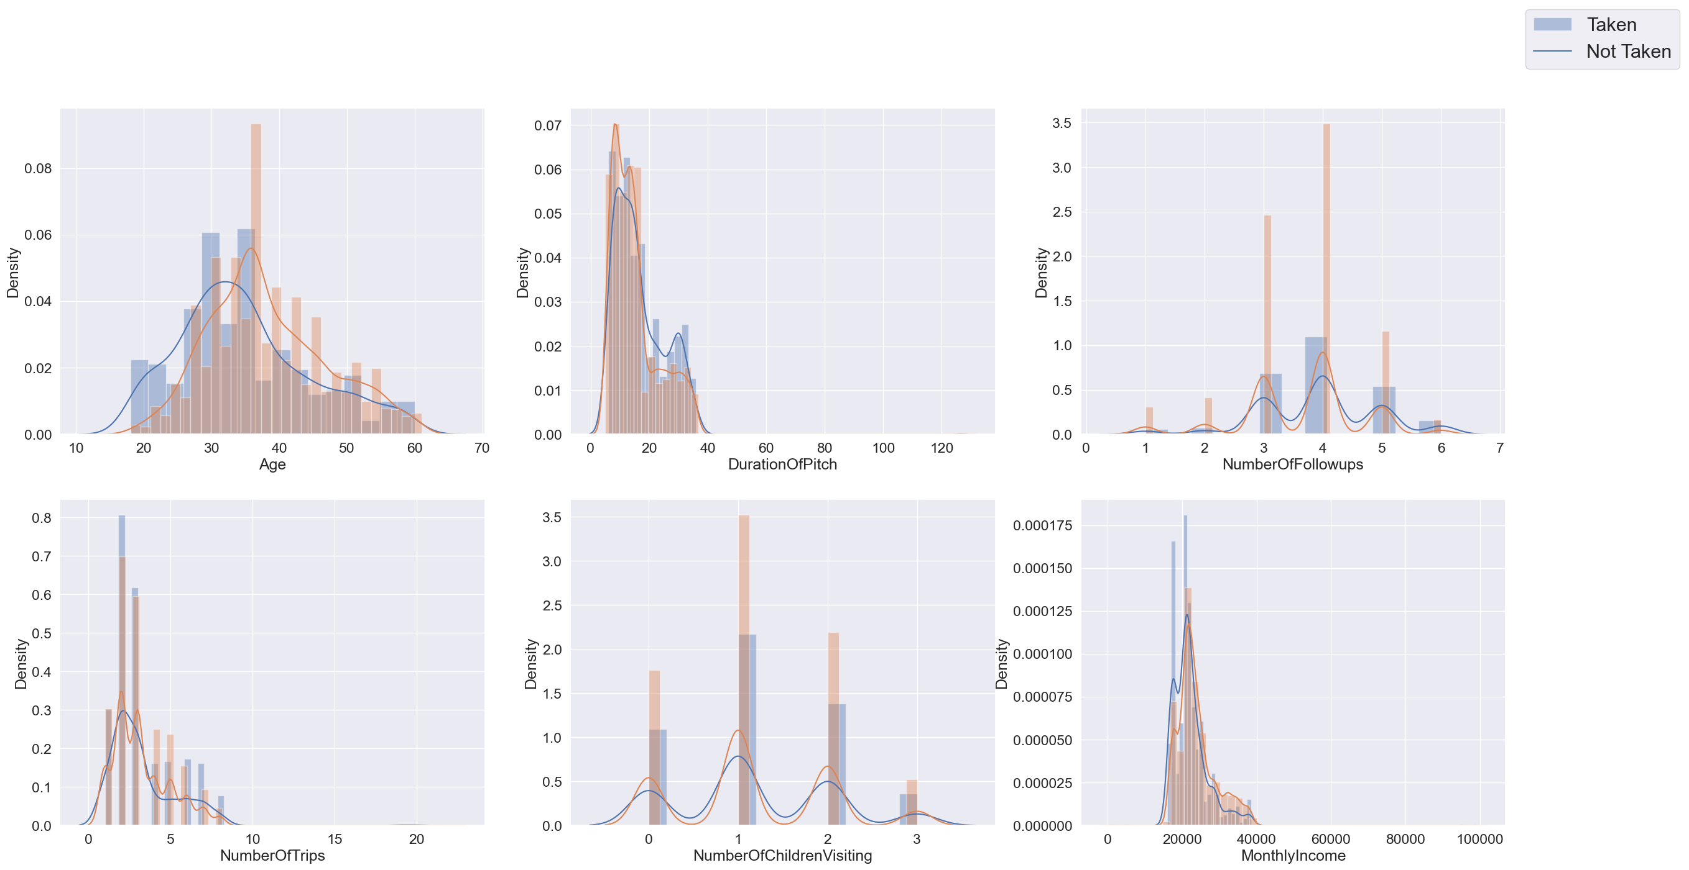
Analysis 6

